Slide 1
Presentation brief for MCT’s
Title of presentation | Working with Data Storage
Presentation\Lab length | Presentation: 40 - 45 minutes. Lab: 40 - 45 minutes.
Audience | Data Professionals, Data Architects, Business Intelligence Professionals, Developers.
Purpose | Introduce Storage Account capabilities. To learn that Azure Data Lake Storage Gen II combines benefits of Azure Blob and ADLS Gen I for improved Big Data storage.
(think) Student key takeaways | The student should understand when using storage accounts is appropriate. Particularly Azure Blob. The student be able to think how, if at all, Data Lake Storage Gen II could be used within their organizations. The student be clear that the creation of a Data Lake Storage Gen II is a checkbox next to enable “hierarchical namespaces”.
(feel) Student desired mindset | The student should feel that they understand why they would use a Storage Account v Data Lake Storage Gen II. The student should feel that the creation of these technologies are straightforward, and not complicated.
(do) Student outcomes | The student be able to understand when to use a storage account and when to use Data Lake Storage Gen II. The student should be able to successfully create a storage account, and upload and download data from the storage account. The student should be able to successfully create a Data Lake Storage Gen II and upload data into it.
More information | For MCT course feedback, visit the Microsoft Official Courseware forum

Slide 2

DP-200T01: Working with Data Storage

Slide 3
Agenda
L01 – Choose a data storage approach in Azure
L02 - Create an Azure Storage Account
L03 - Explain Azure Data Lake Storage
L04 - Upload data into Azure Data Lake Store

Slide 4










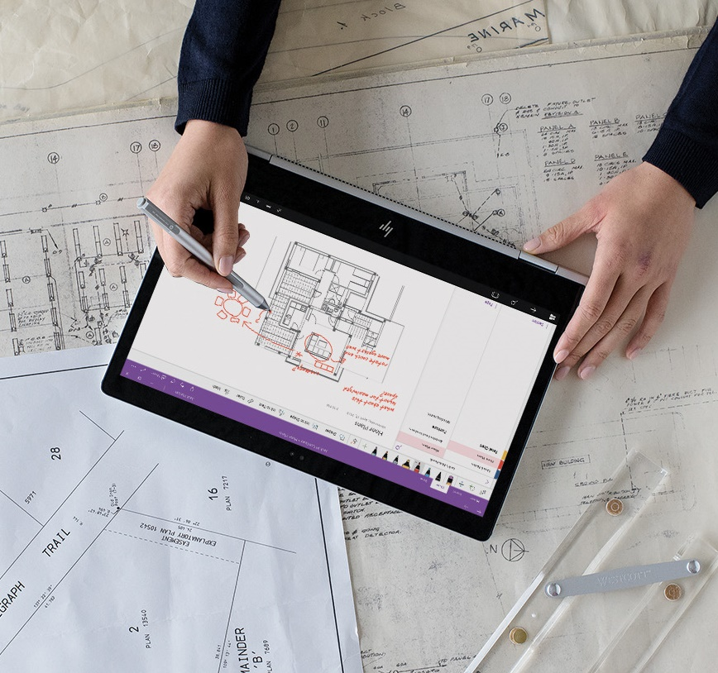


Lesson 01
Choose a data storage
approach in Azure
Data
Cloud
AI

Slide 5
Lesson Objectives
The Benefits of using Azure to store data
Compare Azure data storage with on-premises storage

Slide 6

Benefits of using Azure to store data
Automated
Backup
Global
Replication
Encryption
Capabilities
Multiple
Data Types
Support for
Data Analytics
Storage Tiers
Virtual Disks

Slide 7
Comparing Azure to on-premises storage
The term "on-premises" refers to the storage and maintenance of data on local hardware and servers.
Cost effectiveness
Reliability
Storage types
Agility
On-premises storage requires up-front expenses. Azure data storage provides a pay-as-you-go pricing model.
Azure data storage provides backup, load balancing, disaster recovery, and data replication to ensure safety and high availability. This capability requires significant investment with on-premises solutions
Azure data storage provides a variety of different storage options including distributed access and tiered storage.
Azure data storage gives you the flexibility to create new services in minutes and allows you to change storage back-ends quickly.

Slide 8
Review Questions
Q01 – Suppose you work at a startup with limited funding. Why might you prefer Azure data storage over an on-premises solution?
A01 – The Azure pay-as-you-go billing model lets you avoid buying expensive hardware.
Q02 - Which of the following situations would yield the most benefits from relocating an on-premises data store to Azure?
A02 – Unpredictable storage demand that increases and decreases multiple times throughout the year.

Slide 9
Lesson 02
Create an
Azure Storage Account
Data
Cloud
AI

Slide 10
Lesson Objectives
Describe storage accounts
Determine the appropriate settings for each storage account
Choose an account creation tool
Create a storage account using the Azure portal

Slide 11
Storage accounts
What is a Storage Account
It is a container that groups a set of Azure Storage services. Only data services can be included in a storage account such as Azure Blobs, Azure Files, Azure Queues, and Azure Tables.
The number of storage accounts you need is based on:
*
Data Diversity
Organizations often generate data that differs in where it is consumed and how sensitive it is.
Cost Sensitivity
The settings you choose for the account do influence the cost of services, and the number of accounts you create
Management Overhead
Each storage account requires some time and attention from an administrator to create and maintain.
How many do you need?
The number of storage accounts you need is typically determined by your data diversity, cost sensitivity, and tolerance for management overhead.

Slide 12
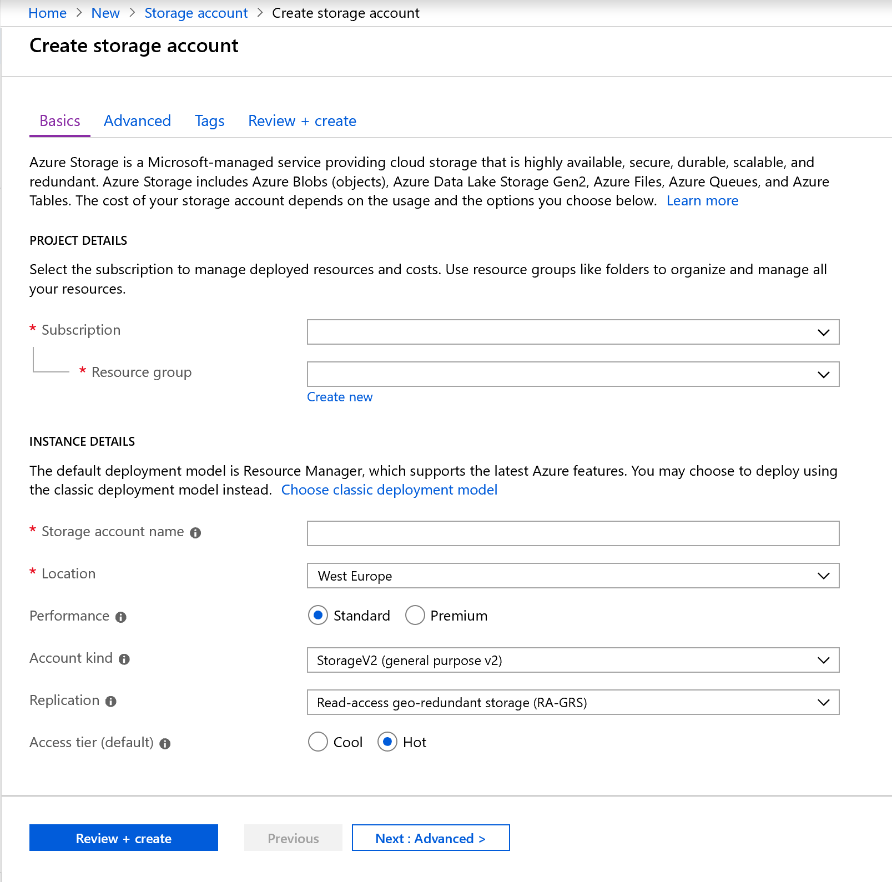
Storage Account Settings

Slide 13





Storage Account Creation Tool
Azure
Portal
Azure Command
Line Interface
Azure PowerShell
Management Client Libraries
13
Notes:
Presenter: Begin the discussion about the value prop for both Microsoft technologies and Microsoft Services.
Talk Track:
Microsoft provides end-to-end business processes that optimize cloud scale, industry-leading security, and manageability. These intelligent solutions enable real-time connections across a wide range of innovative devices. The Microsoft advantage is our highly acclaimed platform—encompassing enterprise data management, analytics, and dynamic user visualization—that can be deployed on-premises, in the cloud, or in a hybrid model.
Microsoft Services can help you to gain breakthrough insight into risk and operational models with advanced analytics solutions. We can give you the tools you need to act on real-time intelligence to optimize risk management and meet regulatory requirements. We can help you to ensure security, privacy, and regulatory compliance; mitigate information and technology risk; drive organizational efficiencies; and gain powerful insights to enhance decision making.
Let’s look at each of these areas in a bit more detail.

Slide 14

Create a Storage Account

Slide 15
Review Questions
Q01 - Suppose you have two video files stored as blobs. One of the videos is business-critical and requires a replication policy that creates multiple copies across geographically diverse datacenters. The other video is non-critical, and a local replication policy is sufficient. True or false: To satisfy these constraints, the two blobs will need to be in separate storage accounts.
A01 – True
Q02 - The name of a storage account must be:
A02 – Globally unique
Q03 - In a typical project, when would you create your storage account(s)?
A03 – At the beginning, during project setup.

Slide 16
Lesson 03
Azure Data Lake Storage
Data
Cloud
AI

Slide 17
Lesson Objectives
Explain Azure Data Lake Storage
Create an Azure Data Lake Store Gen 2 using the portal
Compare Azure Blob Storage and Data Lake Store Gen 2
Explore the stages for processing Big Data Using Azure Data Lake Store
Describe the use cases for Data lake Storage

Slide 18

Azure Data Lake Storage – Generation II
Hadoop Access
Security
Performance
Redundancy

Slide 19
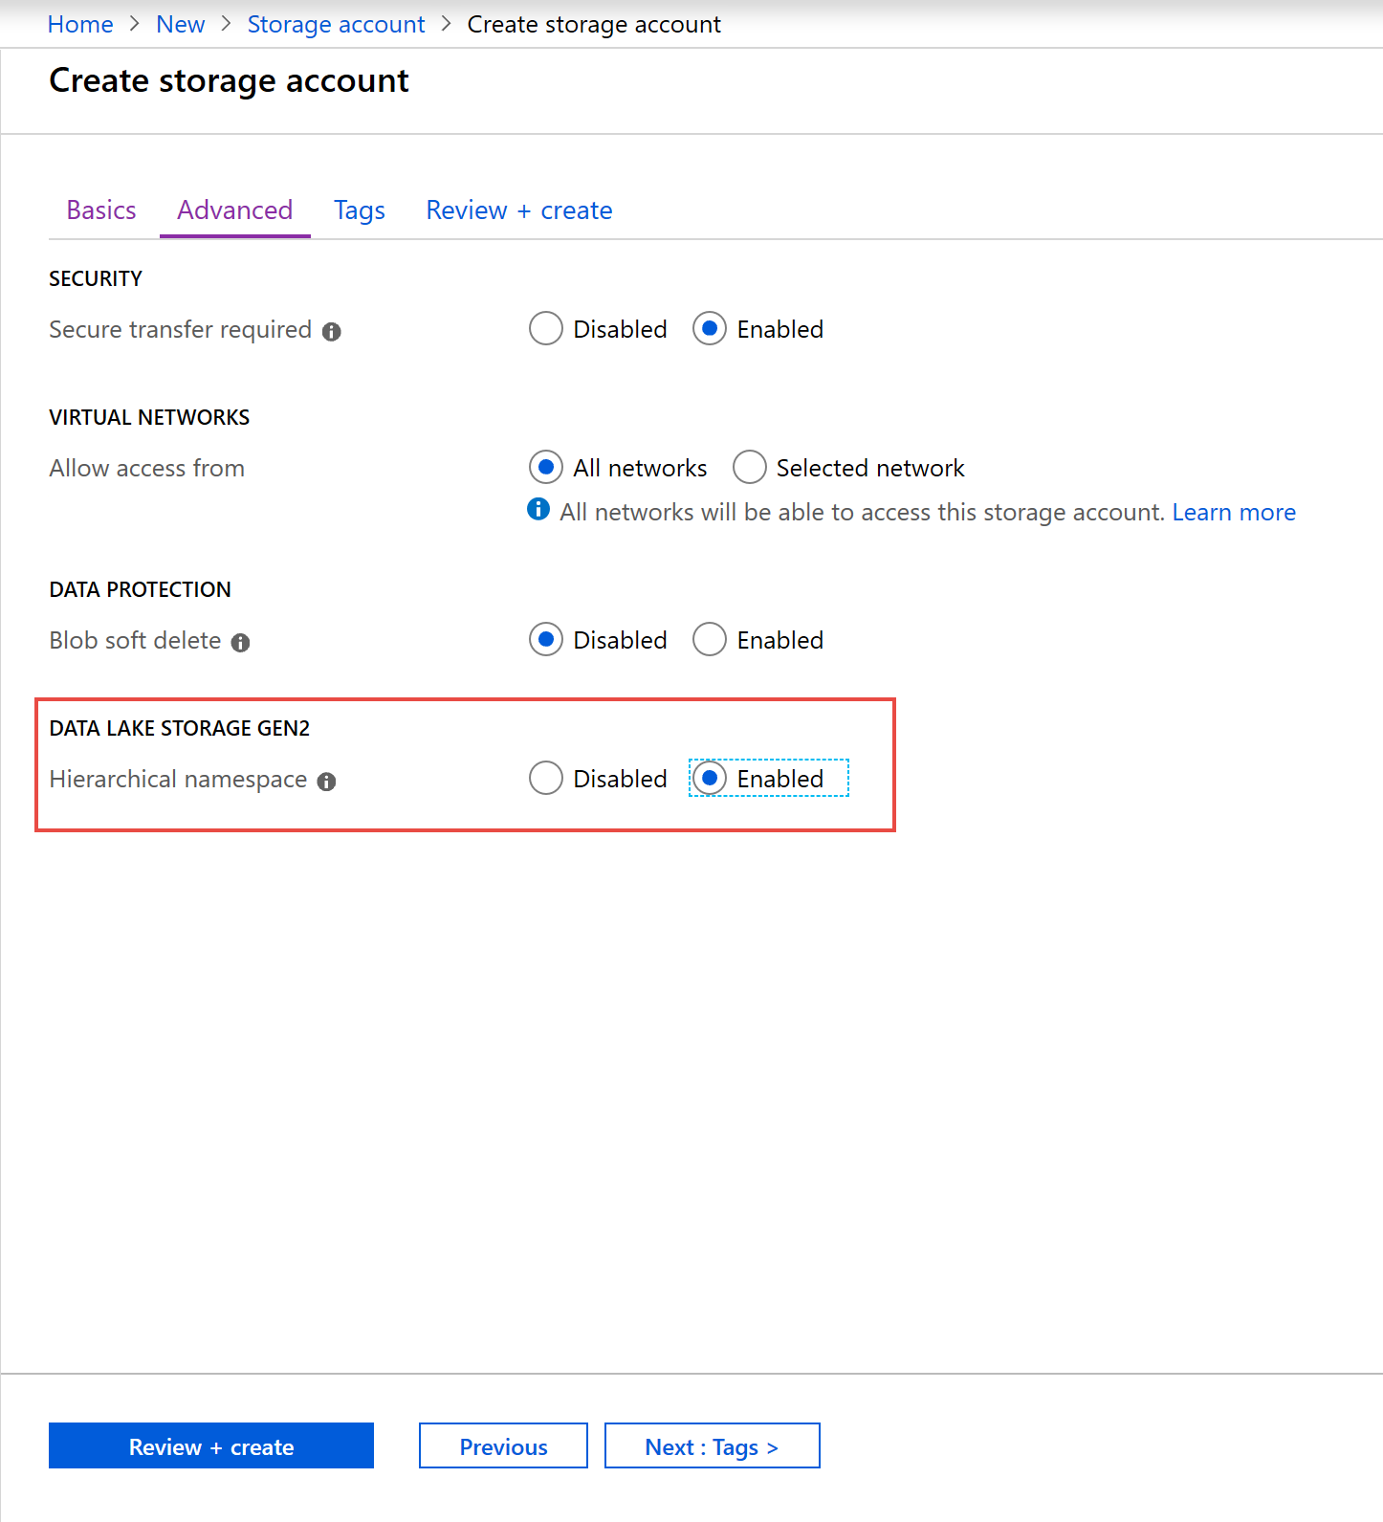
Create a Azure
Data Lake Store (Gen II)
using the Portal.

Slide 20
Compare Azure Blob Storage and Data Lake Store Gen 2
Azure Blob
Flat Namespace
Data Lake (Gen II)
Hierarchical Namespace

Slide 21
Processing Big Data with Azure Data Lake Store
1. Ingestion
2. Store
4. Model & Serve
3. Prep & Train
21
Notes:
Note that this is a variation of the architecting projects example shown in module one. This example views that processing of Big Data solution as typically viewed by a Data Scientist

Slide 22
Big Data Use Cases
Let’s examine three use cases for leveraging an Azure Data Lake Store
Modern Data Warehouse
This architecture sees Azure Data Lake Storage at the heart of the solution for a modern data warehouse. Using Azure Data Factory to ingest data into the Data Lake from a business application, and predictive models built in Azure Databricks.
Advanced Analytics
In this solution, Azure Data factory is transferring terabytes of web logs from a web server to the Data Lake on an hourly basis. This data is provided as features to the predictive model in Azure Databricks, which is then trained and scored. The result of the model is then distributed globally using Azure Cosmos DB, that an application uses.
Real Time Analytics
In this architecture, there are two ingestion streams. Azure Data Factory is used to ingest the summary files that are generated when the HGV engine is turned off. Apache Kafka provides the real-time ingestion engine for the telemetry data. Both data streams are stored in Data Lake store for use in the future.

Slide 23
Review Questions
Q01 – Mike is creating an Azure Data Lake Storage Gen 2 account. He must configure this account to be able to processes analytical data workloads for best performance. Which option should he configure when creating the storage account?
A01 – On the Advanced tab, set the Hierarchical Namespace to enabled
Q02 - In which phase of big data processing is Azure Data Lake Storage located?
A02 – Store

Slide 24
Lesson 04
Upload data into
Azure Data Lake Store
Data
Cloud
AI

Slide 25
Lesson Objectives
Create an Azure Data Lake Gen2 Store using PowerShell
Upload data into the Data Lake Storage Gen2 using Azure Storage Explorer
Copy data from an Azure Data Lake Store Gen1 to an Azure Data Lake Store Gen2

Slide 26
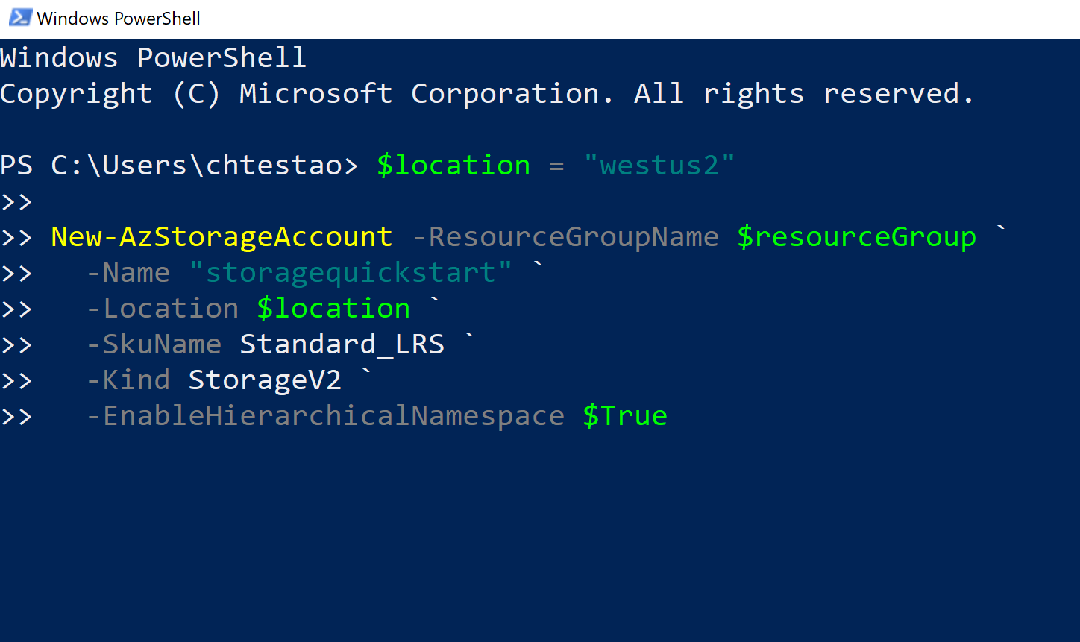
Create a Azure
Data Lake Store (Gen II)
using PowerShell.

Slide 27
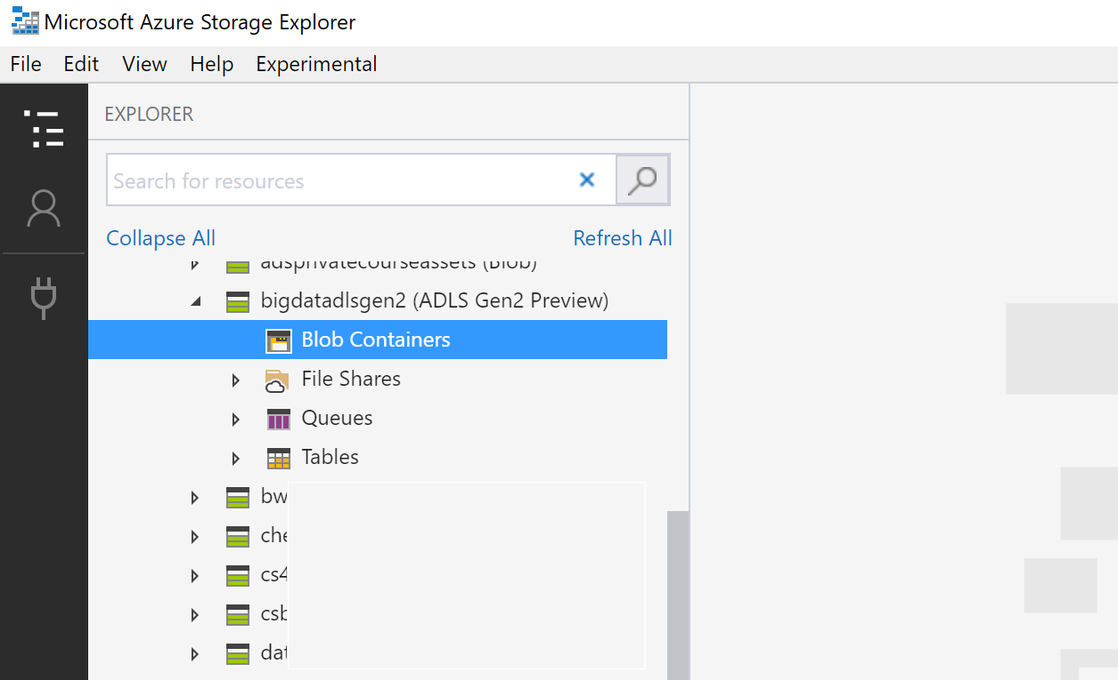
Uploading data with
Azure Storage Explorer

Slide 28
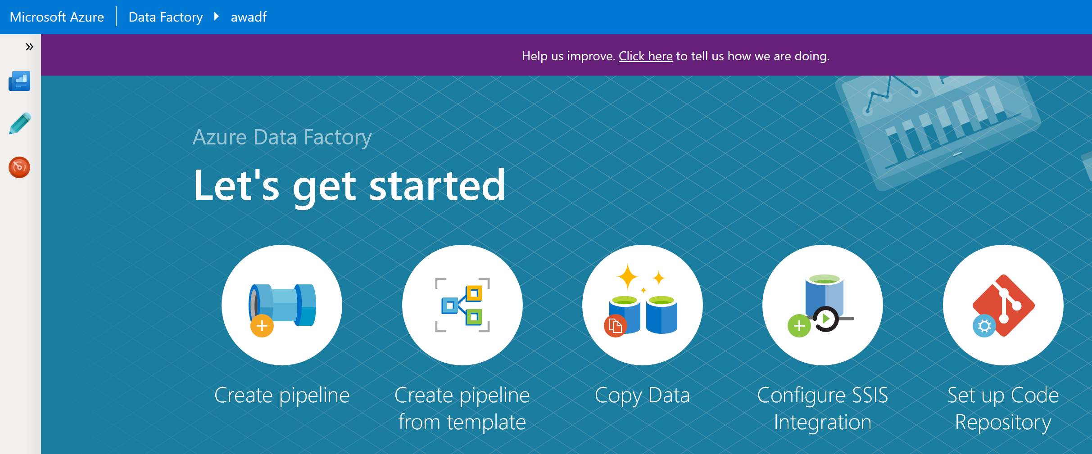
Copy data from an Azure Data Lake Store Gen1 to an Azure Data Lake Store Gen2

Slide 29
Review Questions
Q01 – Contoso has a Data Lake Storage Account (Gen 2). Which tool would be the most appropriate tool to perform a one time without the installation or configuration of a tool to upload of a single file?
A01 – Azure Portal
Q02 - Contoso has a Data Lake Storage Account (Gen 2). Which tool would be the most appropriate tool to perform a movement of hundreds of files from Amazon S3 to Azure Data Lake Storage ?
A02 – Azure Data Factory

Slide 30

Lab: Working with Data Storage

Slide 31
Lab overview
In this lab, the students will be able to determine the appropriate storage type to implement against a given set of business and technical requirements. They will be able to create Azure storage accounts and Data Lake Storage account and explain the difference between Data Lake Storage version 1 and version 2. They will also be able to demonstrate how to perform data loads into the data storage of choice.
Lab objectives
After completing this lab, you will be able to:
Choose a data storage approach in Azure
Create an Azure Storage Account
Explain Azure Data Lake Storage
Upload data into Azure Data Lake

Slide 32
Lab scenario
You have been hired as a Senior Data Engineer to implement a technology solution that is part of a digital transformation project. The organization is migrating an Internet Information Services (IIS) that hosts the company website to Azure. The developers are in the process of transferring the web application and its logic to Azure Web Apps and they have asked you to prepare a data store for them that can be used to host the static images that are used on the website.
In addition, the information services department have informed you that their team is expanding and that they will soon be joined by data scientists that will start the process of building a predictive analytics solution. You have been asked to set up a solution that will be used to host the production environment of their work. In the first instance, you will asses what is the appropriate storage tier to create for the solution.
At the end of this work, you will have:
1. Choose a data storage approach in Azure
2. Create an Azure Storage Account
3. Explain Azure Data Lake Storage
4. Upload data into Azure Data Lake

Slide 33
Lab review
Exercise 1 – Why did you select the option to store the image files?
Exercise 2 – Apart from the Azure Portal, are there other methods to automate the deployment of storage accounts?
Exercise 3 – How is the storage structure of Data Lake Storage Gen II different to Storage Accounts?
Exercise 4 – Where in the Azure Portal would you find Microsoft Azure Storage Explorer?

Slide 34

Next steps
Module Summary
In this module, you have learned about:
- A data storage approach in Azure
- How to create an Azure Storage Account
- How Azure Data Lake Storage Gen2 works
- How to upload data into Azure Data Lake
After the course, consider watching this video with James Baker and Lara Rubbelke that provides an overview of the enhancements of Azure Data Lake Storage Gen2

